Slide 1
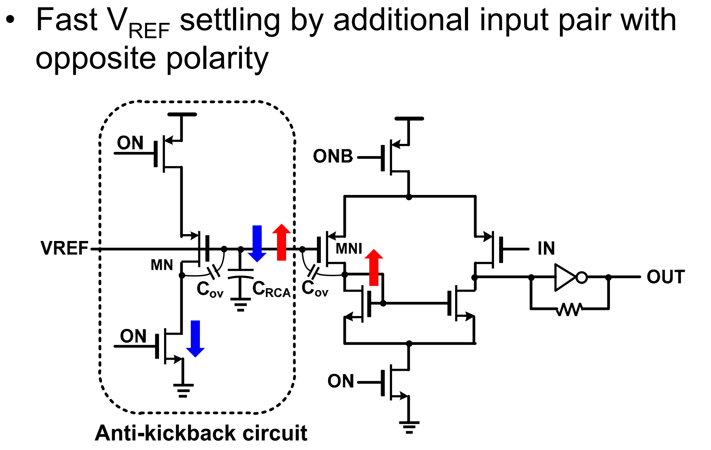
Anti-kickback Circuit 1/1
Lee, Chang-Kyo, et al. "23.2 A 5Gb/s/pin 8Gb LPDDR4X SDRAM with power-isolated LVSTL and split-die architecture with 2-die ZQ calibration scheme." 2017 IEEE International Solid-State Circuits Conference (ISSCC). IEEE, 2017.
Notes:
The slow settling behavior of VREFCA due to an abrupt voltage drop via the overlap capacitor (Cov) of input transistor (MNI) can be alleviated by Cov of an additional coupled transistor (MN) with opposite polarity when power-down exit starts.

Slide 2
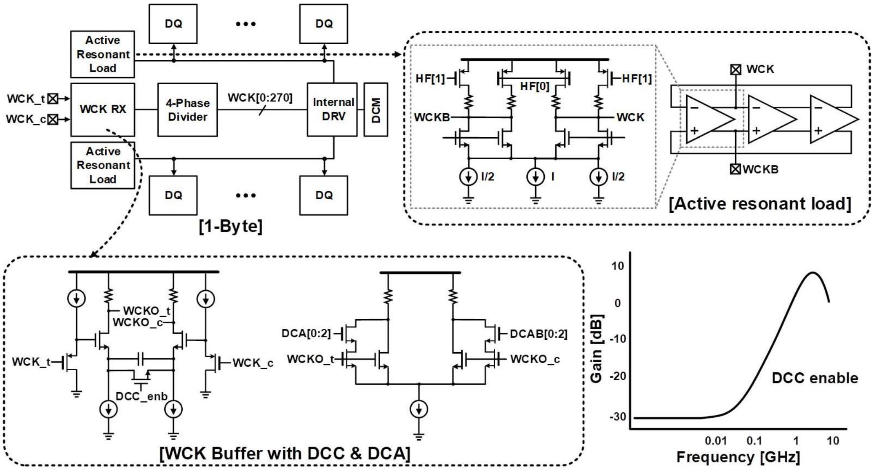
WCK Duty Minimization 1/2
Chi H J, Lee C K, Park J, et al. 22.2 An 8.5 Gb/s/pin 12Gb-LPDDR5 SDRAM with a hybrid-bank architecture using skew-tolerant, low-power and speed-boosting techniques in a 2nd generation 10nm DRAM process[C]//2020 IEEE International Solid-State Circuits Conference-(ISSCC). IEEE, 2020: 382-384.
Notes:
四种方法 DCA DCM ARL DCC
论文说DCC可以把20%的DCD降低到5%？
之前仿真过，印象没有这么厉害，还是导致稳定时间很长
DCA 是在第二级放大器，但是这种形式看起来太像我们现在电路里的OC了，甚至竞品的CLK DQS IB里的offset（我们之前理解的offset），现在再看，还能确定他们真的是offset cal电路吗？有没有可能就是DCA？
或者说这个电路说是DCA or OC都不矛盾，形式是一样的？
终究还是不一样，因为后面真正的OC里面确实看到了类似我们dqs里的，但是确实没发现在DQS 或CLK里用OC的？
ARL

Slide 3
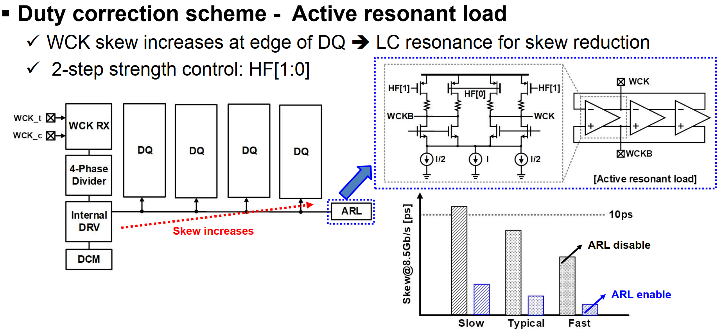
WCK Duty Minimization 2/2
Chi H J, Lee C K, Park J, et al. 22.2 An 8.5 Gb/s/pin 12Gb-LPDDR5 SDRAM with a hybrid-bank architecture using skew-tolerant, low-power and speed-boosting techniques in a 2nd generation 10nm DRAM process[C]//2020 IEEE International Solid-State Circuits Conference-(ISSCC). IEEE, 2020: 382-384.
Notes:
The WCK signals for high speed are employed in LPDDR5 by mitigating the jitter accumulation through the shorten WCK to DQ path. The duty cycle error of the WCK signals should be minimized for high speed because it directly limits the timing margin.
(那我们现在增加了两级，岂不是存在jitter增加的风险？)

Slide 4
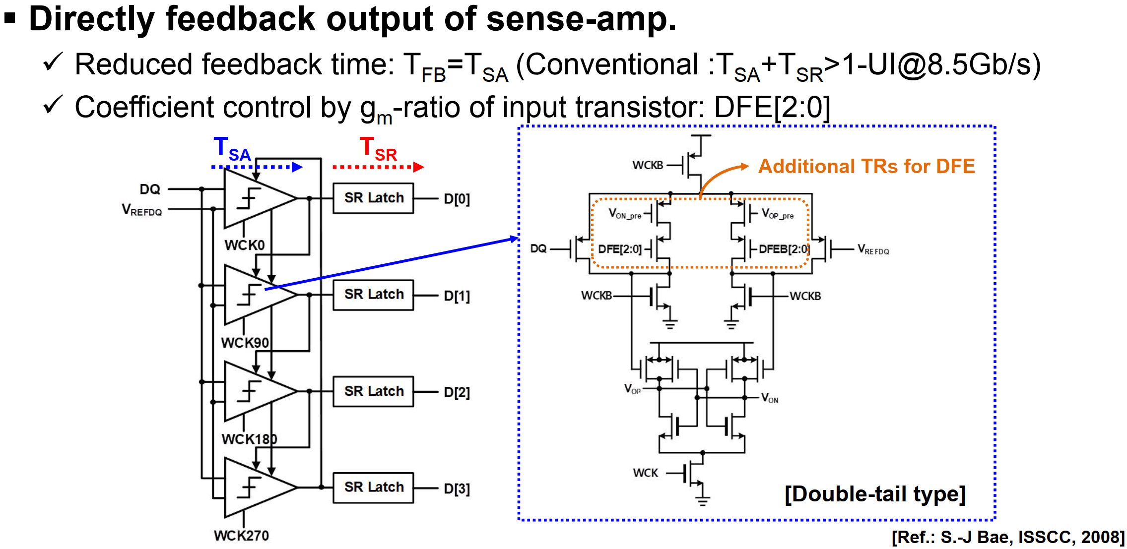
Fast-feedback 1-tap DFE with Offset Calibration 1/3
Chi H J, Lee C K, Park J, et al. 22.2 An 8.5 Gb/s/pin 12Gb-LPDDR5 SDRAM with a hybrid-bank architecture using skew-tolerant, low-power and speed-boosting techniques in a 2nd generation 10nm DRAM process[C]//2020 IEEE International Solid-State Circuits Conference-(ISSCC). IEEE, 2020: 382-384.
Notes:
当CAL_EN信号被激活时，输入对连接到内部参考电压（VCM），通过改变OS[0:7]和OSB[0:7]以及使用内部WCK和控制开关来搜索每个SA的偏移量，并在输出（VOP/VON）转换后设置控制开关，其中8个温度码控制的单元晶体管的初始状态被预先设置为相反极性。

Slide 5
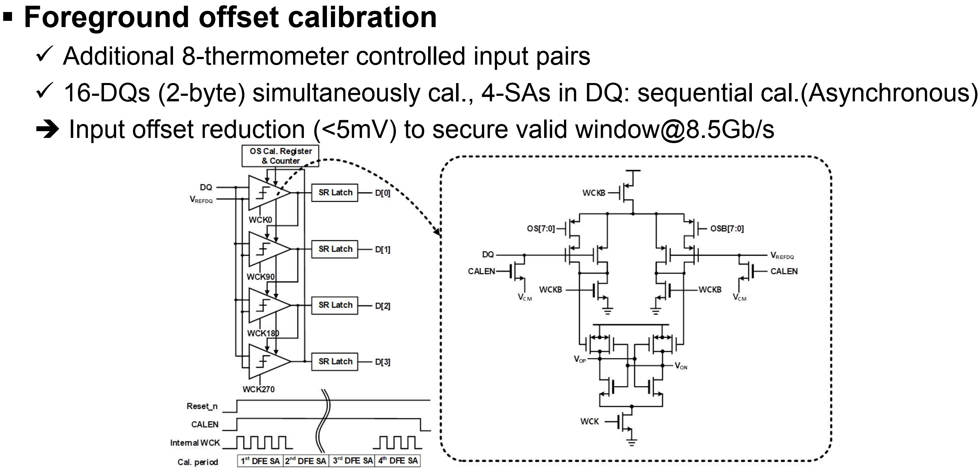
Fast-feedback 1-tap DFE with Offset Calibration 2/3
Chi H J, Lee C K, Park J, et al. 22.2 An 8.5 Gb/s/pin 12Gb-LPDDR5 SDRAM with a hybrid-bank architecture using skew-tolerant, low-power and speed-boosting techniques in a 2nd generation 10nm DRAM process[C]//2020 IEEE International Solid-State Circuits Conference-(ISSCC). IEEE, 2020: 382-384.
Notes:
当CAL_EN信号被激活时，输入对连接到内部参考电压（VCM），通过改变OS[0:7]和OSB[0:7]以及使用内部WCK和控制开关来搜索每个SA的偏移量，并在输出（VOP/VON）转换后设置控制开关，其中8个温度码控制的单元晶体管的初始状态被预先设置为相反极性。

Slide 6
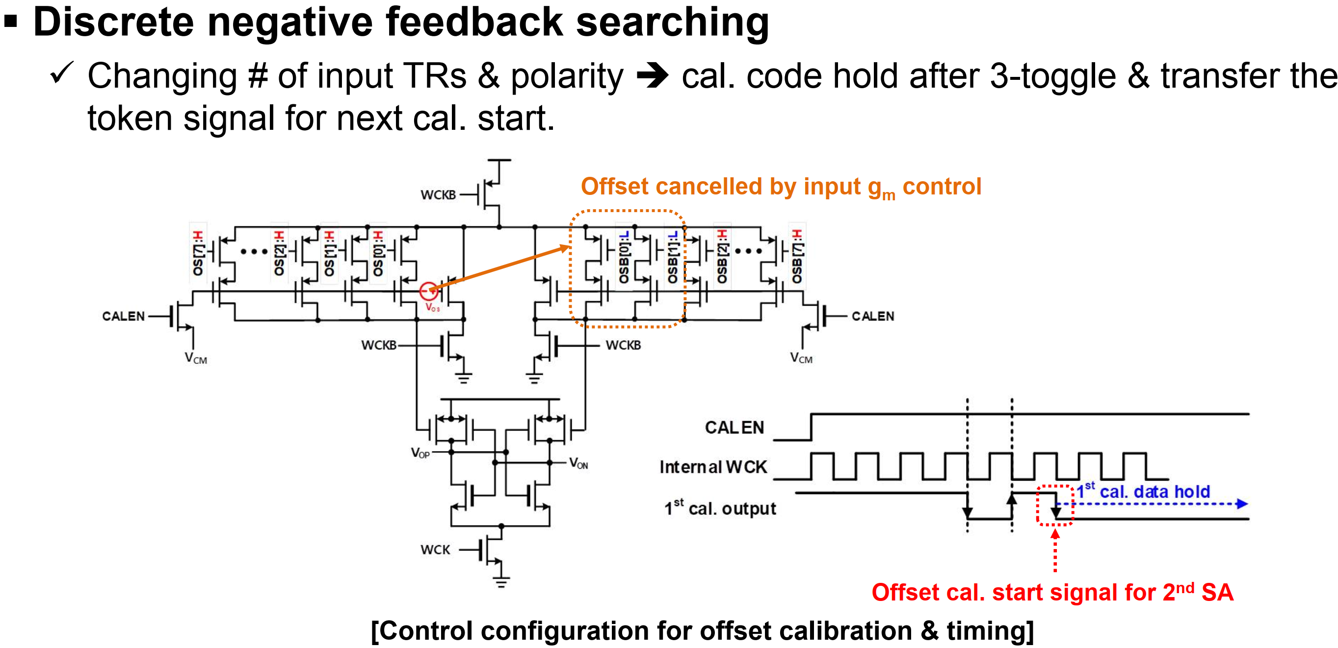
Fast-feedback 1-tap DFE with Offset Calibration 3/3
Chi H J, Lee C K, Park J, et al. 22.2 An 8.5 Gb/s/pin 12Gb-LPDDR5 SDRAM with a hybrid-bank architecture using skew-tolerant, low-power and speed-boosting techniques in a 2nd generation 10nm DRAM process[C]//2020 IEEE International Solid-State Circuits Conference-(ISSCC). IEEE, 2020: 382-384.
Notes:
当CAL_EN信号被激活时，输入对连接到内部参考电压（VCM），通过改变OS[0:7]和OSB[0:7]以及使用内部WCK和控制开关来搜索每个SA的偏移量，并在输出（VOP/VON）转换后设置控制开关，其中8个温度码控制的单元晶体管的初始状态被预先设置为相反极性。

Slide 7
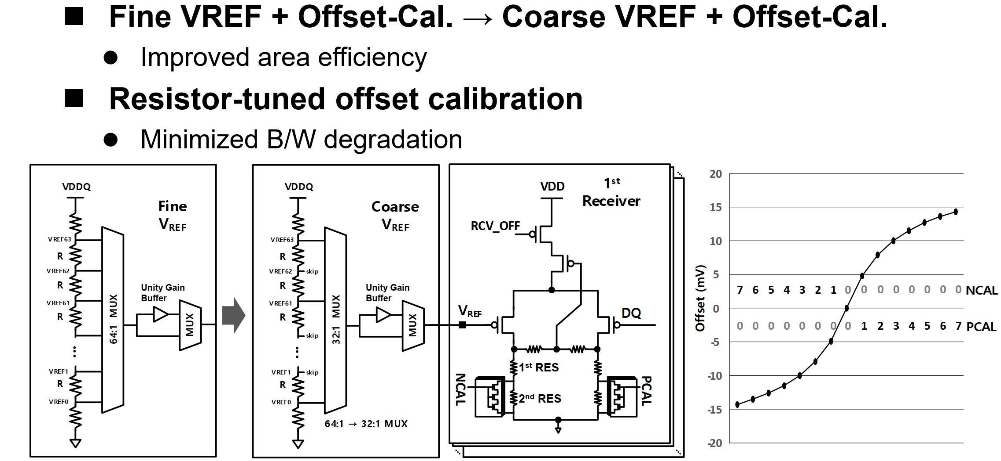
RX I/O with Resistor-Tuned Offset-Calibration 1/1
Chae K, Song J, Choi Y, et al. A 4-nm 1.15 TB/s HBM3 Interface With Resistor-Tuned Offset Calibration and In Situ Margin Detection[J]. IEEE Journal of Solid-State Circuits, 2023.

Slide 8
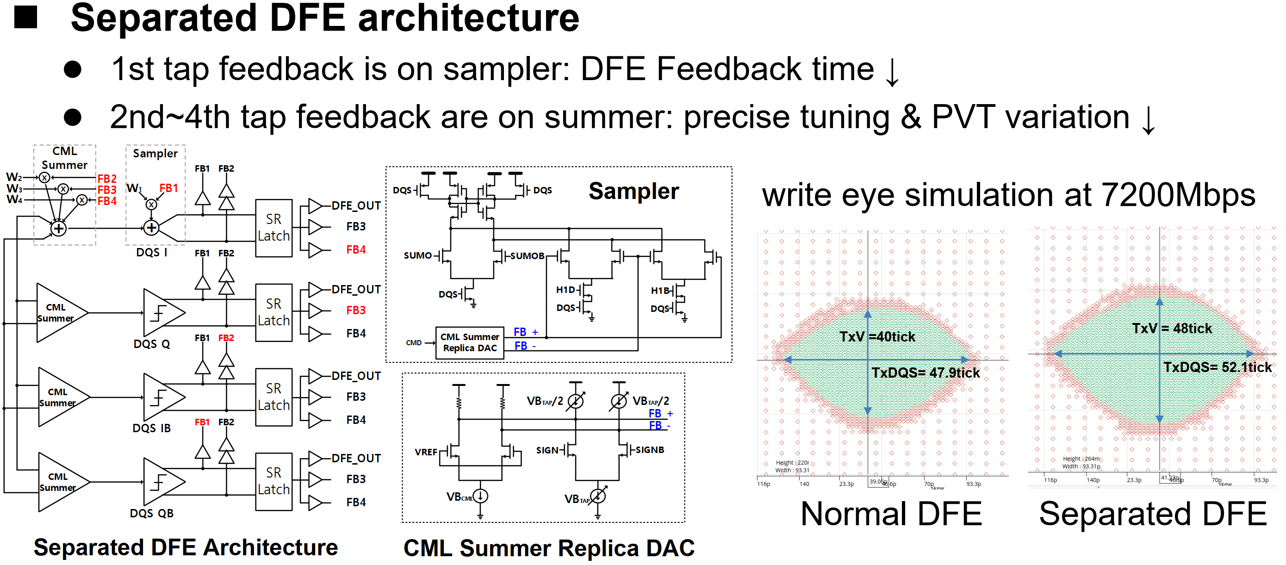
Input offset cal. with majority voting 1/3
Choi I, Hong S, Kim K, et al. 13.2 A 32Gb 8.0 Gb/s/pin DDR5 SDRAM with a Symmetric-Mosaic Architecture in a 5 th-Generation 10nm DRAM Process[C]//2024 IEEE International Solid-State Circuits Conference (ISSCC). IEEE, 2024, 67: 234-236.

Slide 9
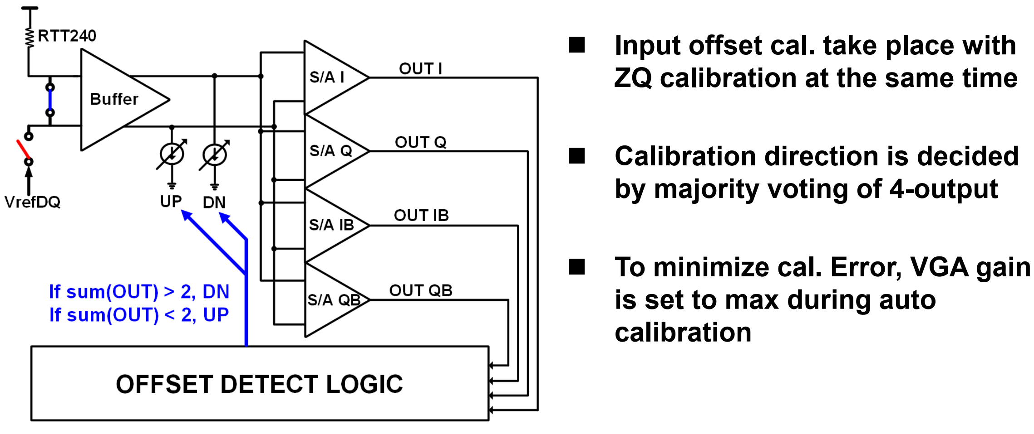
Input offset cal. with majority voting 2/3
Choi I, Hong S, Kim K, et al. 13.2 A 32Gb 8.0 Gb/s/pin DDR5 SDRAM with a Symmetric-Mosaic Architecture in a 5 th-Generation 10nm DRAM Process[C]//2024 IEEE International Solid-State Circuits Conference (ISSCC). IEEE, 2024, 67: 234-236.

Slide 10
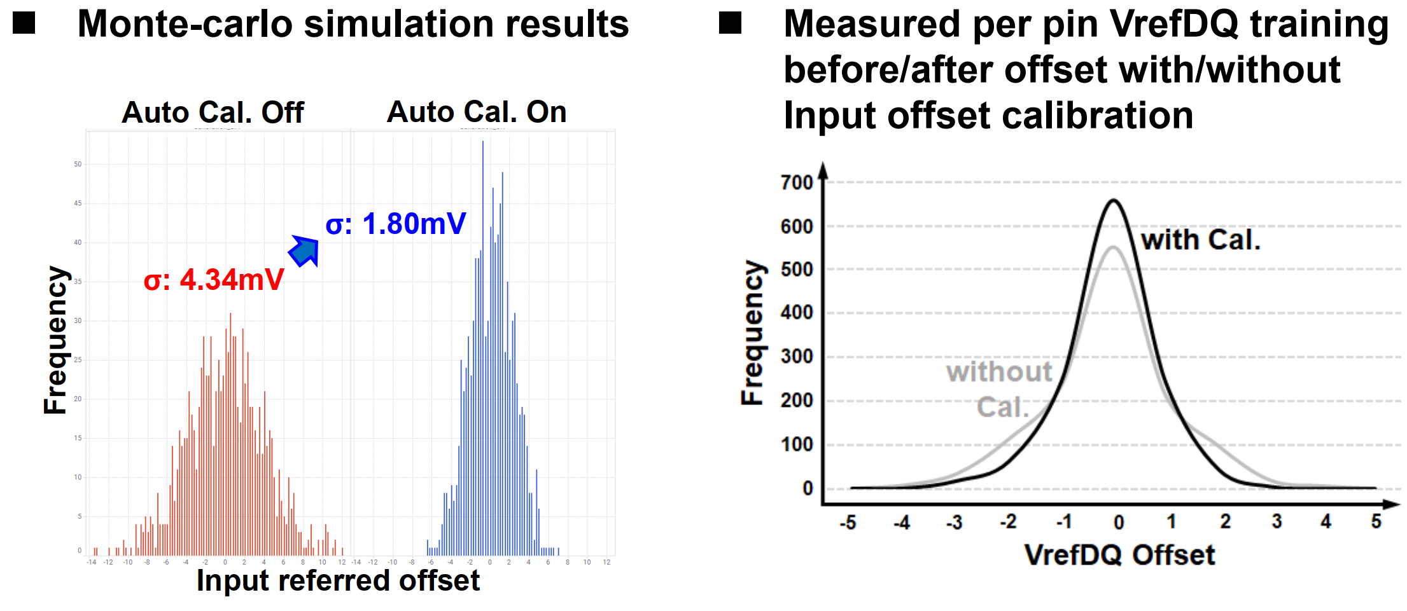
Input offset cal. with majority voting 3/3
Choi I, Hong S, Kim K, et al. 13.2 A 32Gb 8.0 Gb/s/pin DDR5 SDRAM with a Symmetric-Mosaic Architecture in a 5 th-Generation 10nm DRAM Process[C]//2024 IEEE International Solid-State Circuits Conference (ISSCC). IEEE, 2024, 67: 234-236.

Slide 11
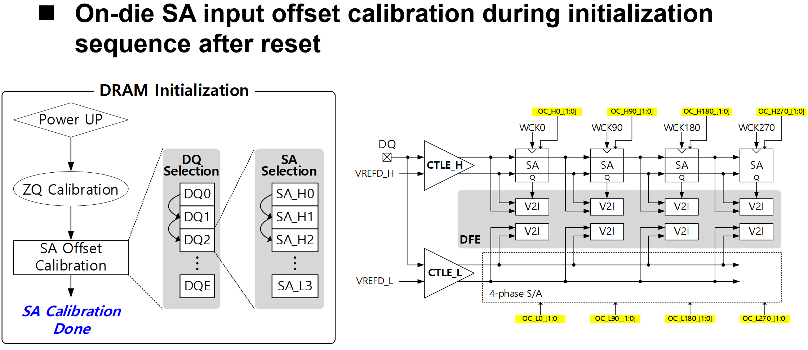
SA Calibration 1/2
Cho S Y, Choi M C, Baek J, et al. 13.6 A 16Gb 37Gb/s GDDR7 DRAM with PAM3-Optimized TRX Equalization and ZQ Calibration[C]//2024 IEEE International Solid-State Circuits Conference (ISSCC). IEEE, 2024, 67: 242-244.

Slide 12
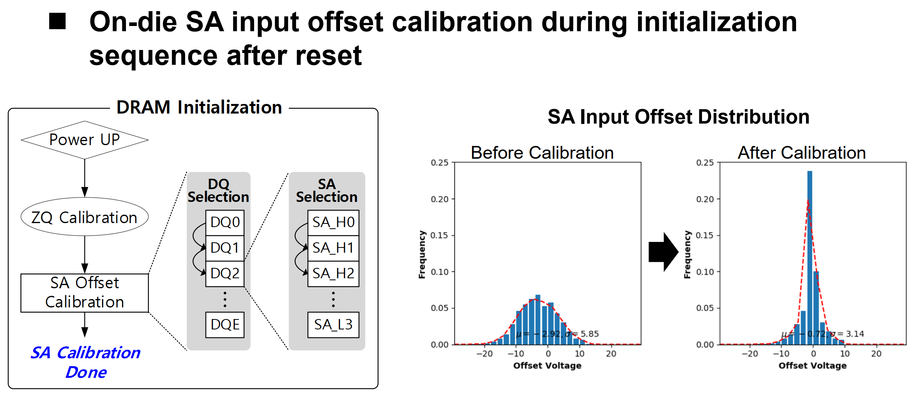
SA Calibration 2/2
Cho S Y, Choi M C, Baek J, et al. 13.6 A 16Gb 37Gb/s GDDR7 DRAM with PAM3-Optimized TRX Equalization and ZQ Calibration[C]//2024 IEEE International Solid-State Circuits Conference (ISSCC). IEEE, 2024, 67: 242-244.

Slide 13
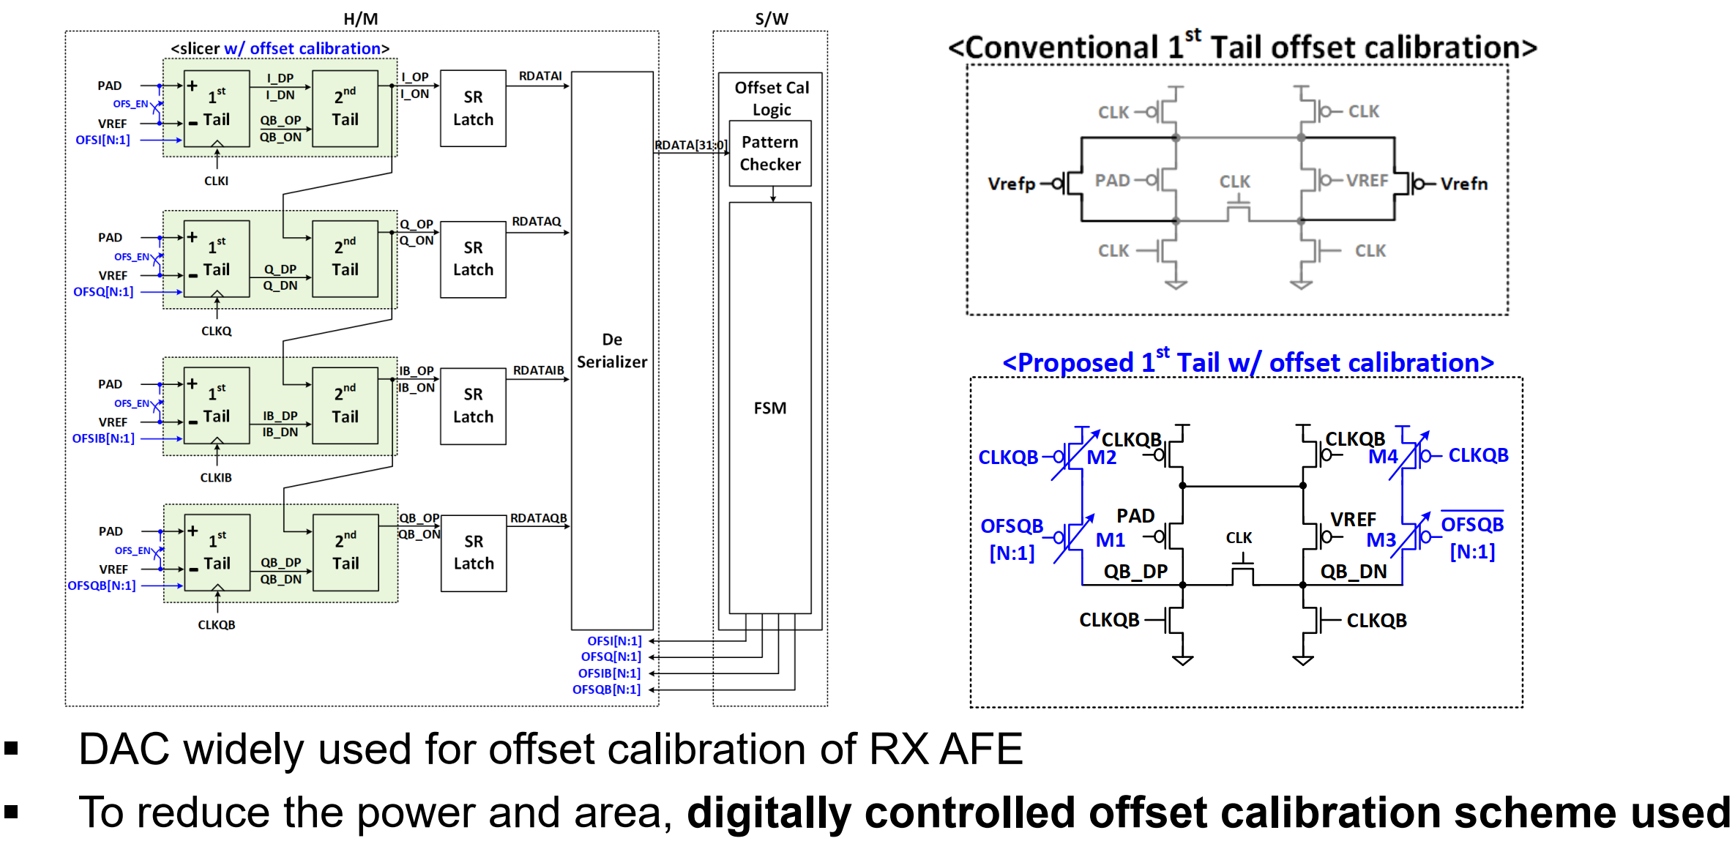
RX AFE – Offset Calibration Scheme 1/2
Seong K, Oh W, Lee H, et al. 13.10 A 4nm 48Gb/s/wire Single-Ended NRZ Parallel Transceiver with Offset-Calibration and Equalization Schemes for Next-Generation Memory Interfaces and Chiplets[C]//2024 IEEE International Solid-State Circuits Conference (ISSCC). IEEE, 2024, 67: 250-252.

Slide 14
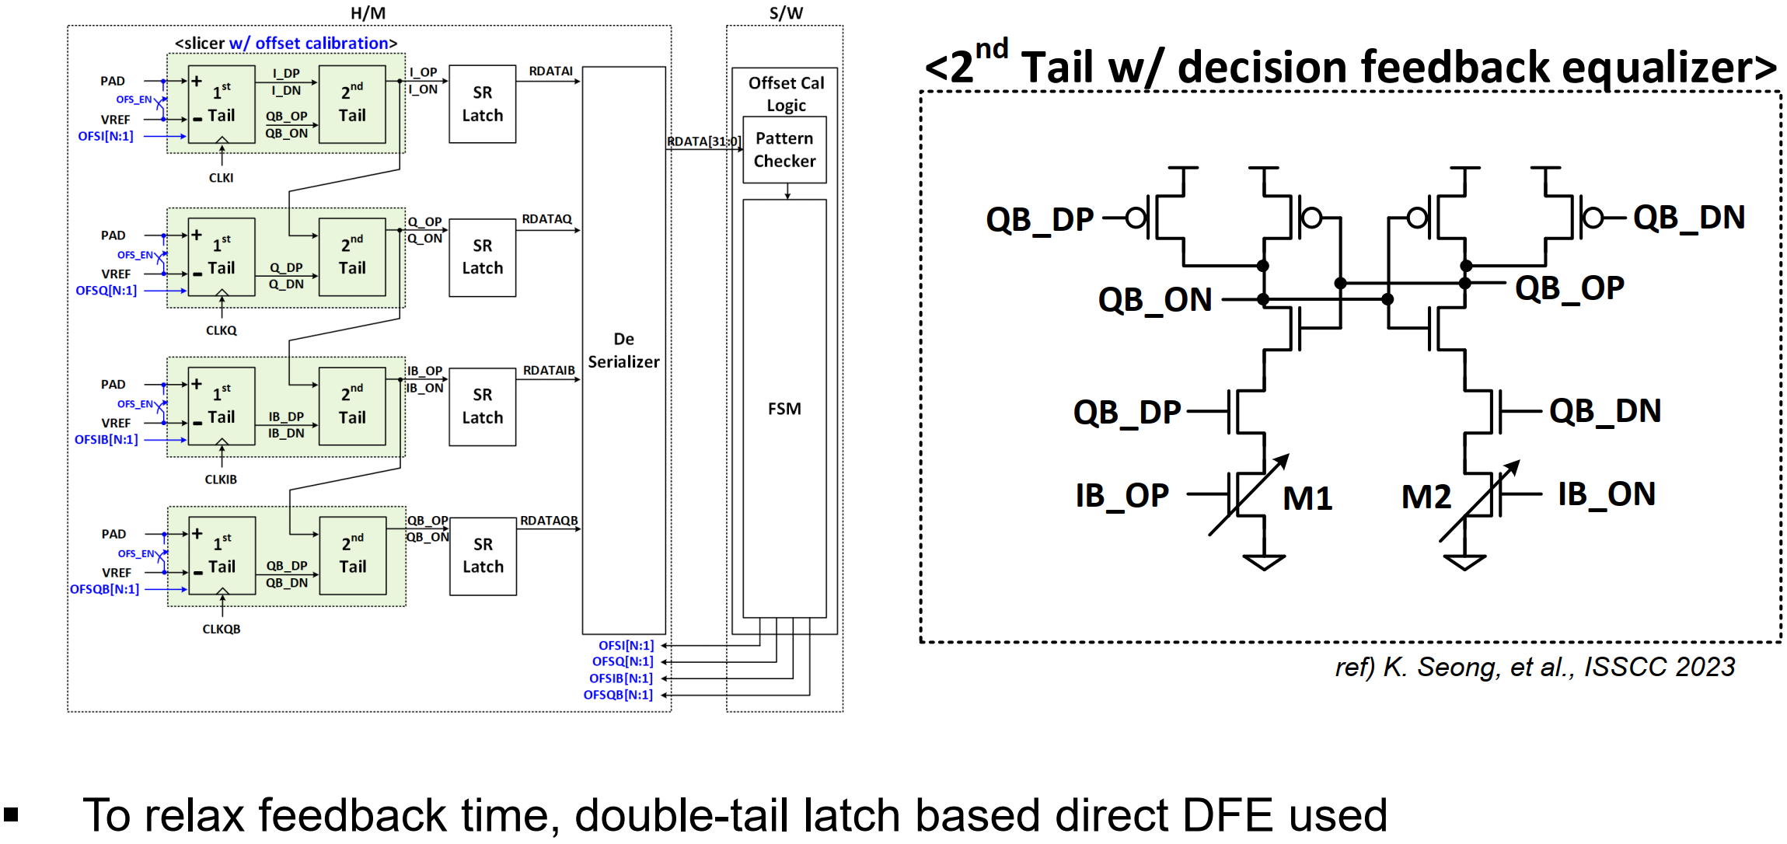
RX AFE – Offset Calibration Scheme 2/2
Seong K, Oh W, Lee H, et al. 13.10 A 4nm 48Gb/s/wire Single-Ended NRZ Parallel Transceiver with Offset-Calibration and Equalization Schemes for Next-Generation Memory Interfaces and Chiplets[C]//2024 IEEE International Solid-State Circuits Conference (ISSCC). IEEE, 2024, 67: 250-252.

